Slide 1
Introduction to Robotics – Assignment 2

Slide 2
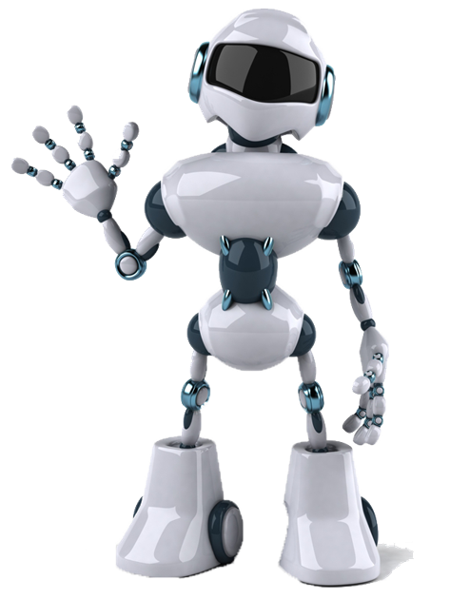
Question 1: What is the definition of a robot?
A robot is a machine—especially one programmable by a computer—capable of carrying out a complex series of actions automatically. A robot can be guided by an external control device, or the control may be embedded within. Robots may be constructed to evoke human form, but most robots are task-performing machines, designed with an emphasis on stark functionality, rather than expressive aesthetics.

Slide 3
Question 2: What are the three main components of a robot?
Sensors are what allow a robot to gather information about its environment.
The effectors are the parts of the robot that actually do the work.
Control Systems (the "brains") A robot's "control system" is that part of the robot that determines the robot's behavior.

Slide 4
Question 3: What are the main types of robots based on their application?
Industrial Robots
Domestic Robots
Surgical Robots
Robonauts is a NASA robot. Engineers designed Robonaut to be humanoid, which means it is built to look like a person. This makes it easier for Robonaut to do the same jobs as a person.
Commercial Entertainment Robots
Army Robots
Service Robots

Slide 5
Question 4: Give 3 examples of sensors that helps a robot understand its environment.
Light sensors — to detect light.
Sound sensors — to detect sound.
Temperature sensors — to detect fluctuations in temperature.

